Slide 1

“Protect Me When I’m Vulnerable”
FINAL PRESENTATION
Debasis Kar, Deepak Kumar, Abhilash Mishra

Slide 2
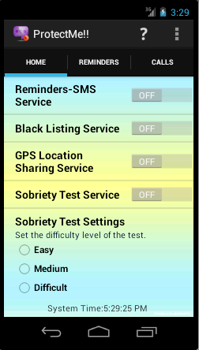
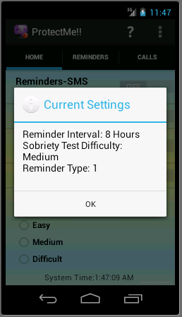
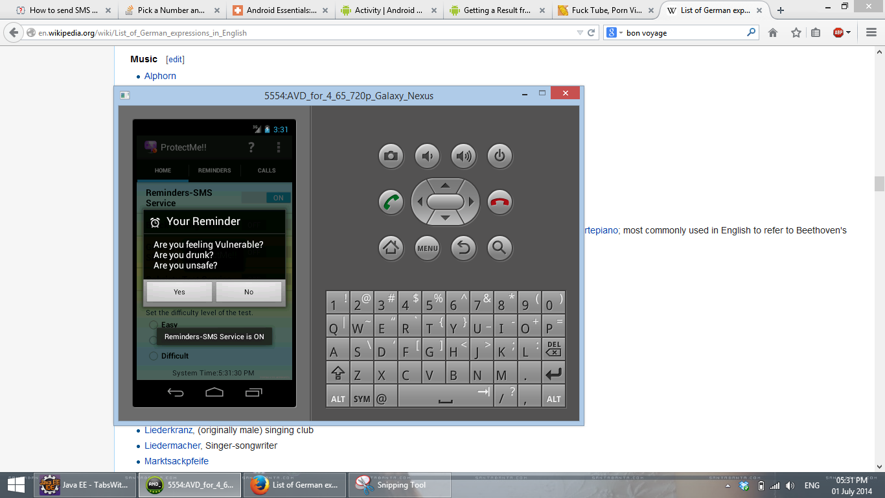
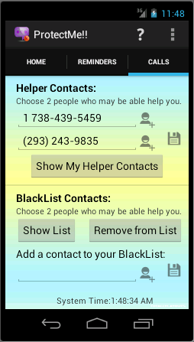
Version 1.0 of Application

Slide 3
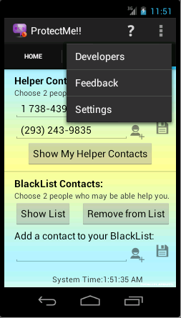
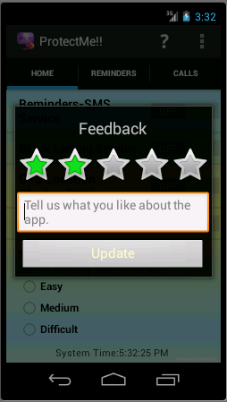

User Feedback Study
EMAIL INBOX
deepakkumar.ce@gmail.com
Reviews
Reviews
(No Developer Account for PlayStore ☹)
ProtectMe!! v1.0 APK file is available at:
http://goo.gl/d0OQaw

Slide 4

The Whole Road Map

Slide 5
Final Plan Summary
Domain Analysis
Existing Software Review
Existing Document Review
Requirement Gathering
Questionnaire
Interview with target groups
Requirement Analysis
Use Case Analysis
Context Analysis
Results
Requirements & Context

Slide 6
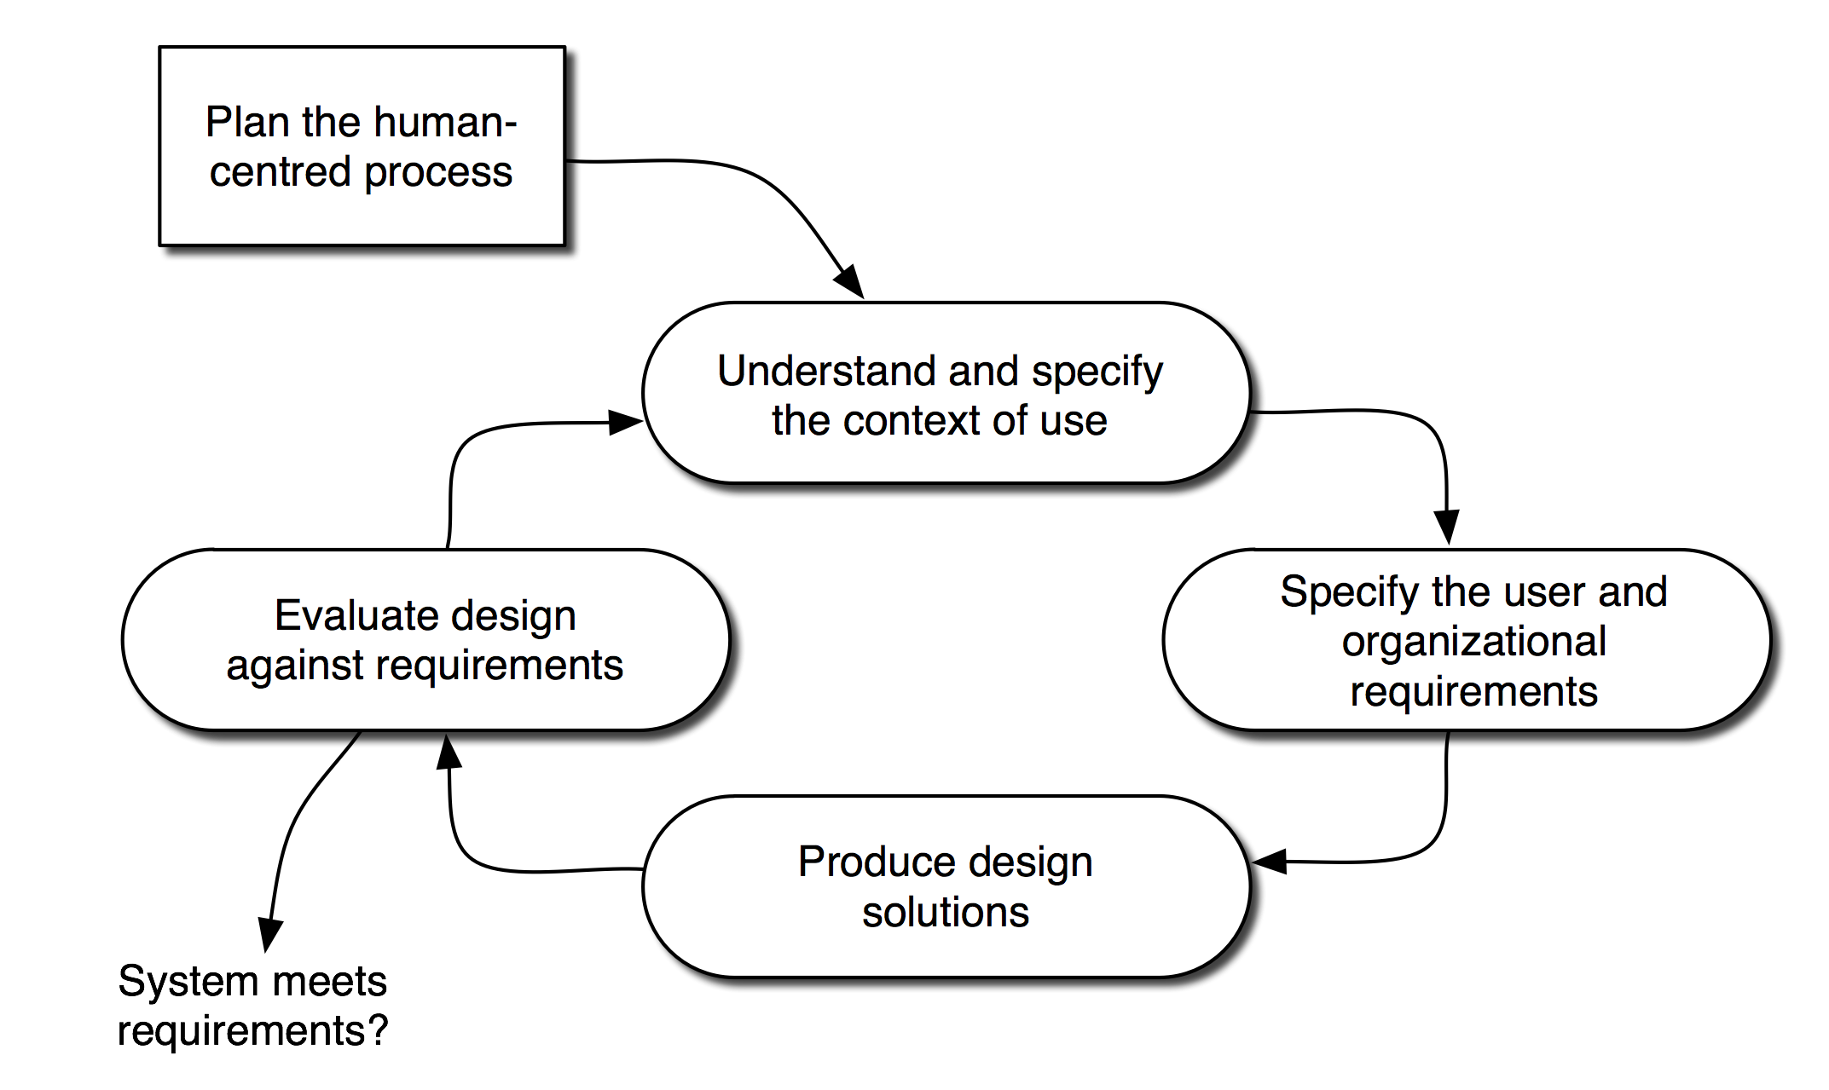
Human Centered Design Model
Goal:
“To develop an app using human-centered design model
with required usability and utility.”

Slide 7
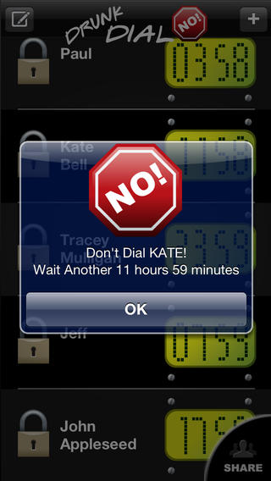
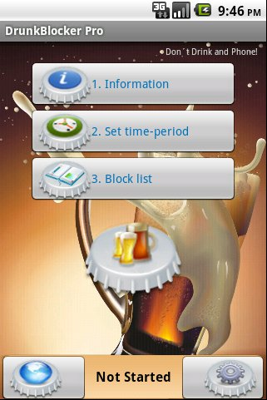
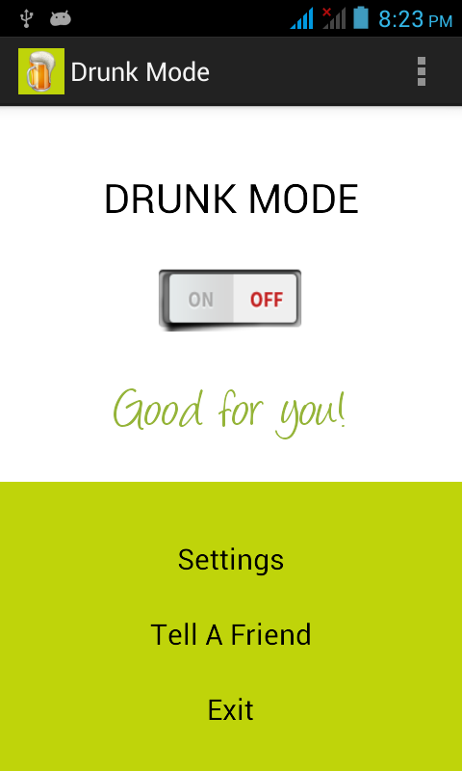
Existing Software Review
Courtesy: Drunk Dial No!
Courtesy: DrunkBlocker Pro
Courtesy: Drunk Mode

Slide 8
Requirement Gathering Phase
Factors/Severity | (Lowest) 1 | 2 | 3 | 4 | 5 (Highest) | Cumulative | Score
GPS Location Sharing For Help | 1 | 0 | 4 | 8 | 9 | 90 | 4.09
Reminders Whether You're OK | 1 | 3 | 9 | 5 | 4 | 84 | 3.82
Emergency Call to Relatives | 0 | 2 | 9 | 3 | 8 | 83 | 3.77
Speed Dial Pop-up | 2 | 2 | 5 | 8 | 5 | 78 | 3.55
Sobriety Test Before Call | 3 | 4 | 4 | 5 | 6 | 73 | 3.32
Blocking Call To Boss/GFs/BFs | 3 | 3 | 5 | 7 | 4 | 72 | 3.27
Reminders About Sex/Drive | 2 | 5 | 3 | 9 | 3 | 72 | 3.27
WhatsApp Integration | 3 | 5 | 4 | 5 | 5 | 70 | 3.18
Factors/Importance | (Lowest) 1 | 2 | 3 | 4 | 5 (Highest) | Cumulative | Score
Functionality / Utility | 0 | 1 | 1 | 5 | 15 | 100 | 4.55
Look & Feel (Usability) | 0 | 1 | 5 | 9 | 7 | 88 | 4.00
Price and Others | 1 | 0 | 6 | 7 | 8 | 87 | 3.95

Slide 9
Context of Use
Platform: Android 4.0+ (Most Used Android API: ICS)
Technical Knowledge Needed: Very Less. App is for naïve users.
Software Development Model:
Iterative Prototype Model
User Centered Designing Model
Target Audience:
Medical Emergent People, People consuming heavy Alcohol etc.
User Design Guideline:
Pictorial Buttons would be better than textual ones because they can catch attention easily.
Application should be intuitive, otherwise it would be irritating for some mundane tasks.

Slide 10
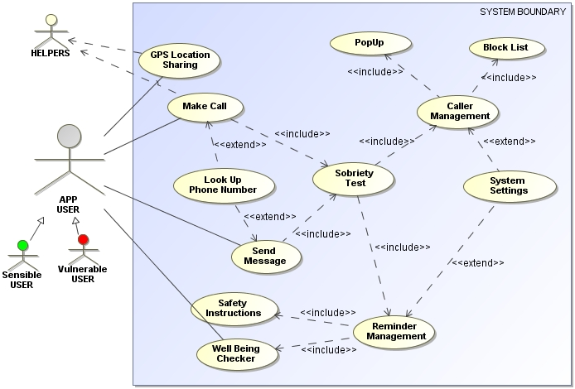
Preliminary Use Case

Slide 11
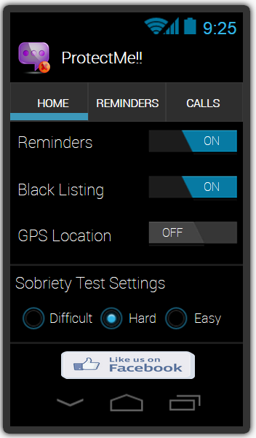
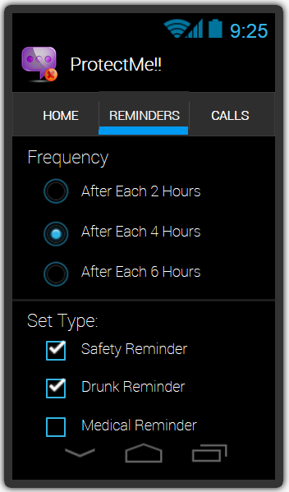
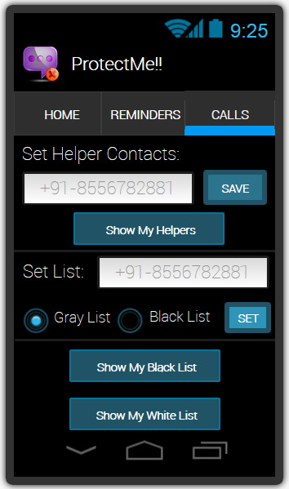
Initial Prototyping
Initial Prototype is developed in this stage, where the very basic requirements are showcased and user interfaces are provided.

Slide 12
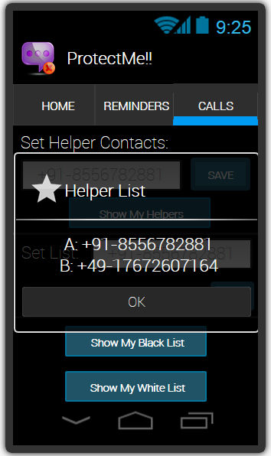
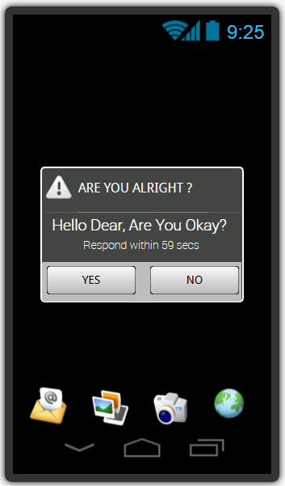
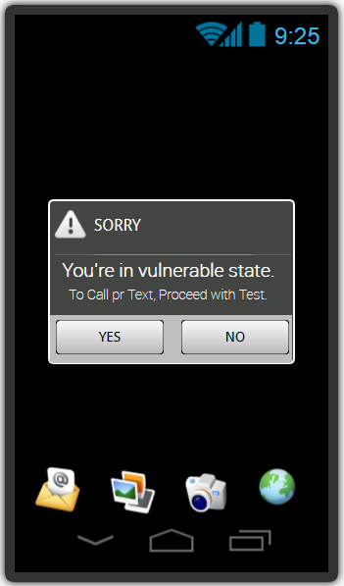
Initial Prototyping Contd..

Slide 13
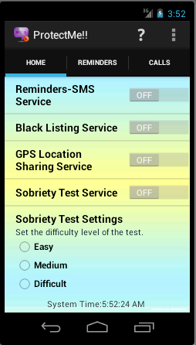
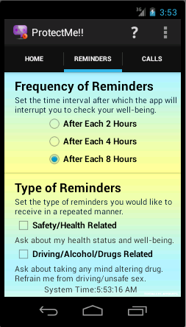
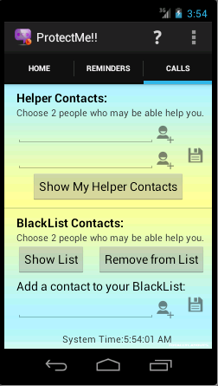
Refined Design of UI

Slide 14
User Review Study
Hypothesis (Statement that we want to evaluate):
Regular app notifications are irritating.
GUI of our App is intuitive than others available in Play Store.
Application is of intended quality.
GUI workflow is moderately easy than other apps in Play Store.
Population (Intended Users):
Medically Challenged
Susceptible to Mind-altering Substances
Emotionally Weak
General Public
Method:
Email Based Application Feedback
One-to-One Meeting with Few Friends

Slide 15

User Review Study
Independent Variables:
GUI Layout
Workflows of our GUI
Conditions:
Similar apps available in PlayStore. [Experimental]
Dependent Variables:
Functionality offered by the app (by Rating)
Task completion time
(by measuring the time taken by user to initiates initial settings of the app)
Error Rate
(by measuring when a user asks for any help in GUI handling)

Slide 16
Collected Ratings & Data
Mode = 3
Median = 3
Mean = 2.54
Variance = 0.92
SD = 0.96
Count = 37

Slide 17
Collected Ratings & Data
Mode = 0
Median = 1
Mean = 1.03
Variance = 1.03
SD = 1.01
Count = 37

Slide 18
Collected Ratings & Data
Mode = 120
Median = 100
Mean = 98.78
Variance = 1540.84
SD = 39.25
Count = 37

Slide 19
7 Picked User Reviews out of 37
Rating: 4.0 − Nice App!! Features are good. Calls tab is not so intuitive. Improve the GUI more.
Rating: 3.0 − Sobriety test is not there I suppose. Quality needs improvement.
Rating: 3.0 − Useful. Background color is too dim. Lightweight and Outgoing call blocking works perfect as you’ve said.
Rating: 3.0 − Sobriety test not working.
Rating: 2.0 − GPS sharing stuck at times.
Rating: 2.0 − Functionalities are good. Regular alerts are somewhat disgusting.
Rating: 1.0 − It sucks big time. How can u say that I’m drunk or not!! (-X

Slide 20

Inferences out of User Review
Have to Implement Sobriety Test Module.
GUI improvement is needed in Notifications.
Users do like important customized notifications.
Many users like the intended use of the app.
App is not very intuitive, not mundane though.
App task completion time can be assumed to low.
From User-ratings, one can say that It needs many
improvements, yet it has few good functionalities.

Slide 21


Lessons Learnt / Outcomes
Executed Human-Centered Design Model as much as possible.
Followed Android UX guidelines.
Worked on a evolutionary prototype, rather than a throw-away one.
Learnt many technical aspects such as:
Broadcast Receivers
Android Services
Background Process Execution
Fragmented GUI Design
Timer Controlled Intent Management

Slide 22

Future Ahead
Sobriety Test Module
GUI Enhancement
SMS/MMS Blocking
WhatsApp or Twitter Integration
A sensor based approach if it’s there!!

Slide 23

THANK YOU!!!

